Slide 1
Introduction to Git & GitHub For Research
Why and how Git/GitHub helps research
Antoine Valera – 27/02/2025

Slide 2
Common Issues
Work Protection
"My computer crashed and I lost all my changes from today!"
"I deleted something important last week but I can't find it in any of my backups...“
Research Reproducibility
"The reviewers want us to modify Figure 3, but I can't remember exactly how I generated it..."
"Can we reproduce the analysis we did 6 months ago?"
"Which version of the preprocessing script did we use for the published results?“
“Can we test the new segmentation method they used in the micro-sam paper on our data?”
Version Management
"Which one of these is my latest version? script_v3_final_FINAL_tested.py or script_v3_final_FINAL_tested_new.py?"
"I know I have the working version somewhere in my Downloads folder...“
"I need to try a different approach but I don't want to break the working code..."
Collaboration
"I'll send you my version via email - just don't edit it until I'm done with my part!“
"Wait, did you change the code? I was working on that same section...“
" Can you tell me what you modified? We're going to need to manually compare these two files to merge our work...“

Slide 3
Common Issues
Work Protection
Reliable backup system, Ability to recover changes, Safe space for experimentation
Research Reproducibility
Ability to replicate experiments exactly, Documentation of analysis steps, Tracing which code produced which results
Version Management
Keeping track of file versions, Managing code evolution
Collaboration
Sharing code effectively, Integrating changes from multiple researchers, Keeping everyone's work synchronized

Slide 4
What is Version Control? What is Git?
Version Control
A system that records changes to files over time (incrementally)
Acts like a "time machine" for your code and documents
Keeps track of who changed what, when, and why
Git
The most widely used version control system
Free, open-source, and industry standard
Keep tracking changes in the background while you work

Slide 5

How git works
Computer 1
Git clone
🤓 You at work : File 1 V1 File 2 V1 …
🤓 You at work : File 1 V2 File 2 V1 …
Git commit
You save snapshots ("commits") of your files
Each snapshot has a message explaining the changes
You can go back to any previous snapshot
🤓 You at work : File 1 V3 File 2 V2 …
Git commit
Git push
Server
Computer 2
Git pull
🦉 You at home : File 1 V3 File 2 V2 …
😱 You at home : File 1 V2 File 2 V2 …
Git commit
Git push

Slide 6
Computer 1
Computer 1
🤓 You at work : File 1 V2 File 2 V2 …
Git clone
🤓 You at work : File 1 V1 File 2 V1 …
🤓 You at work : File 1 V2 File 2 V1 …
Git commit
🤓 You at work : File 1 V3 File 2 V2 …
Git commit
Server
Git push
Server
Computer 2
Git pull
🦉 You at home : File 1 V3 File 2 V2 …
😱 You at home : File 1 V2 File 2 V2 …
Git commit
Git push

Slide 7
Computer 1
Computer 3
🤓 You at work : File 1 V2 File 2 V2 …
👶Your collaborator : File 1 V2 File 2 V2 …
Git clone
🤓 You at work : File 1 V2 File 2 V4 …
👶Your collaborator : File 1 V4 File 2 V2 …
Git commit
Git commit
Git push / Git pull
Git push / Git pull
🤓 You at work : File 1 V4 File 2 V4 …
👶Your collaborator : File 1 V4 File 2 V4 …
Server
Multiple people can work on the same project safely
Multiple people can work on the same file simultaneously
Git includes system to resolve merging conflicts
➔ For more complex scenario, we can use “branches”

Slide 8
Common Issues
Work Protection
Reliable backup system, Ability to recover changes, Safe space for experimentation
Research Reproducibility
Ability to replicate experiments exactly, Documentation of analysis steps, Tracing which code produced which results
Version Management
Keeping track of file versions, Managing code evolution
Collaboration
Sharing code effectively, Integrating changes from multiple researchers, Keeping everyone's work synchronized

Slide 9
Computer 1
Computer 3
🤓 You at work : File 1 V2 File 2 V2 …
👶Your collaborator : File 1 V2 File 2 V2 …
🤓 You at work : File 1 V2 File 2 V4 …
👶Your collaborator : File 1 V4 File 2 V2 …
Git commit
Server branch 1 / branch 2
Git commit
Git push / Git pull
Git push / Git pull
🤓 You at work : File 1 V4 File 2 V4 …
👶Your collaborator : File 1 V4 File 2 V4 …
Server
➔ Major or simultaneous changes may not be compatible

Slide 10
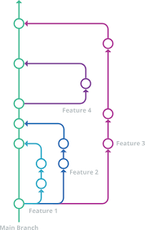
Branches
Main Branch (Green)
→ The primary version of your project
→ Think of it as your "production" or "stable" code
Feature Branches (Blue, Purple)
→ Create a branch to work independently on new features without affecting main code
Basic Operations
→ PULL: Get latest changes from remote repository
→ PUSH: Send your changes to remote repository
→ MERGE: Combine changes from a feature branch back to main
This branching system allows multiple people to work simultaneously without conflicts

Slide 11
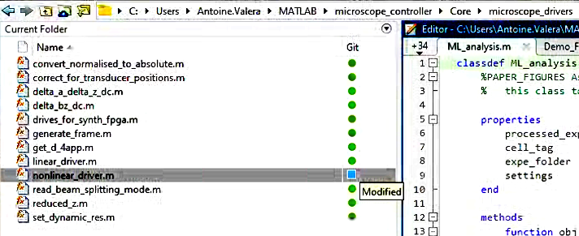
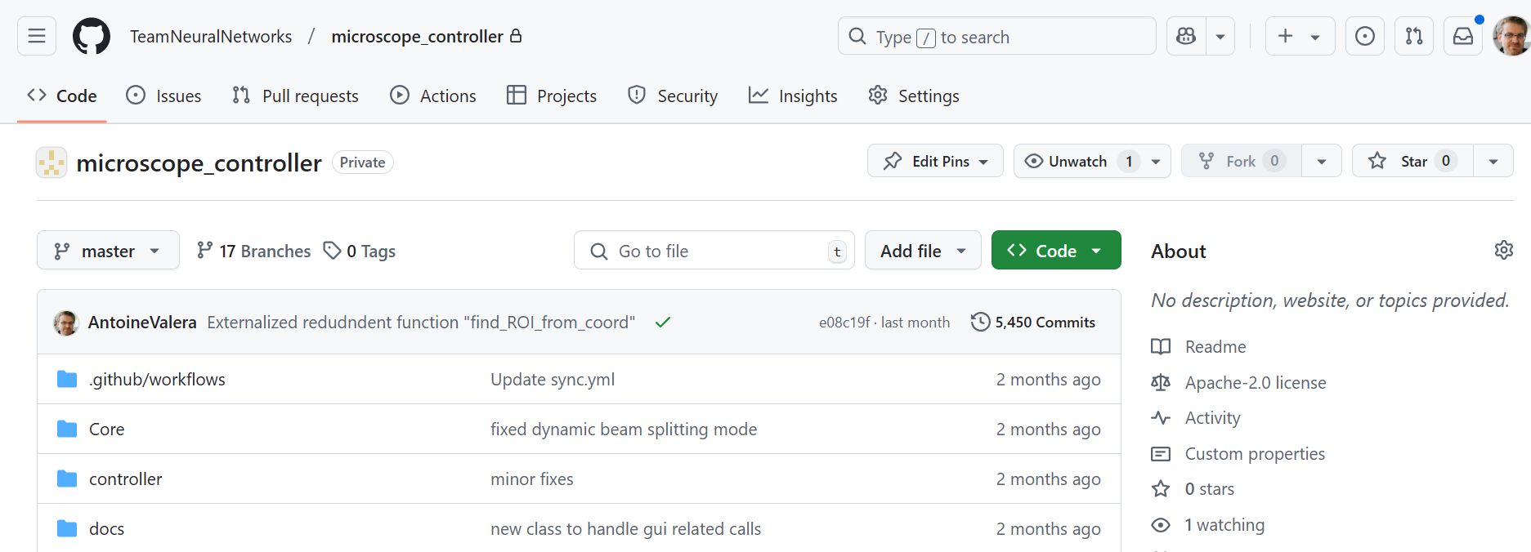
Git vs. GitHub/GitLab
Git
The version control system itself
Runs on your computer
Tracks changes in your files
Works completely offline
Hosting Platforms
Store Git repositories online
Provide collaboration features
Different options available:
GitHub (Microsoft)
GitLab (can be self-hosted)
Bitbucket (By Atlassian)
SourceForge (Older platform)

Slide 12
Important Note: GitHub ≠ Backup System
GitHub stores your code, but...
→ Not designed as a backup solution
→ Limited file size (100MB per file)
→ No guaranteed uptime or redundancy
What to use GitHub for
→ Code version control and collaboration
→ Documentation and small data files
→ Project management and issue tracking
What NOT to use GitHub for
Large datasets
Sensitive or private data
System backups
Binary files (images, videos, etc.)
➔ Use proper backup solutions (lab servers, institutional storage, etc.) for your research data

Slide 13
GitHub Structure
Users (individual mail address)
Organizations (e.g., Institute repository, Team repository)
→ Groups multiple related projects/labs under one umbrella
→ Manages team access and permissions centrally
Example: Our institute INCI's organization, my team webpage
Repositories (e.g., microscope_controller)
→ Individual projects or code bases
→ Can be public or private
Can be owned by Users or Organizations
Example: my microscope controller software project

Slide 14

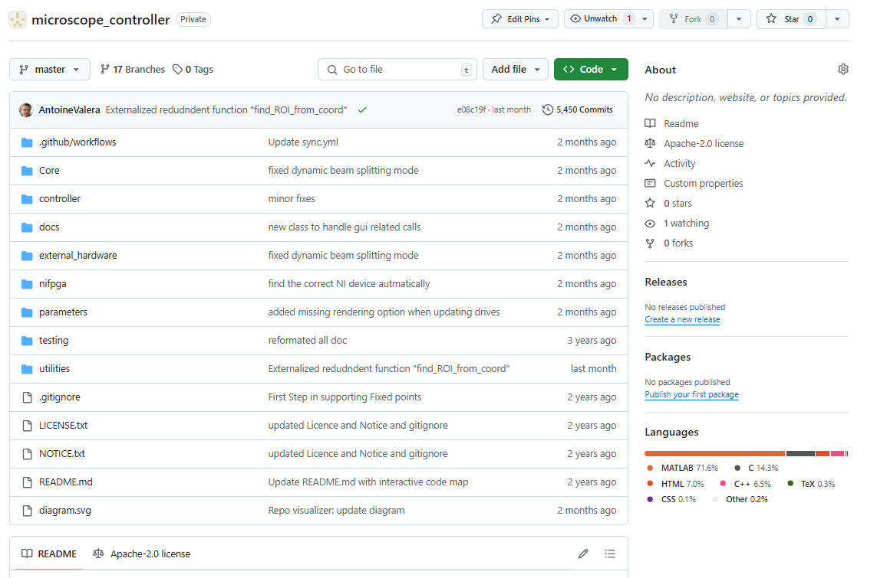
What does GitHub look like

Slide 15
What does GitHub look like
Example of organization with Public and Private repositories
https://github.com/TeamNeuralNetworks/
Example of Private repository
https://github.com/TeamNeuralNetworks/microscope_controller
Example of Public repository with a DOI
https://github.com/TeamNeuralNetworks/the-inspiring-tuby-sniff
Example of “hub”
https://github.com/SilverLabUCL/SilverLab-Microscope
https://github.com/NeuroStrasbourg/

Slide 16
GitHub Repository Structure
Key Areas of a Repository
→ Code: Where your files live
→ Issues: Track bugs and feature requests
→ Pull Requests: Propose and review changes
→ Projects: Organize and track work
→ Wiki: Project documentation
→ Settings: Manage repository configuration
Navigation
→ Top menu for core features
→ README displays automatically on homepage
→ Sidebar for additional information
→ Watch/Star/Fork buttons for engagement

Slide 17
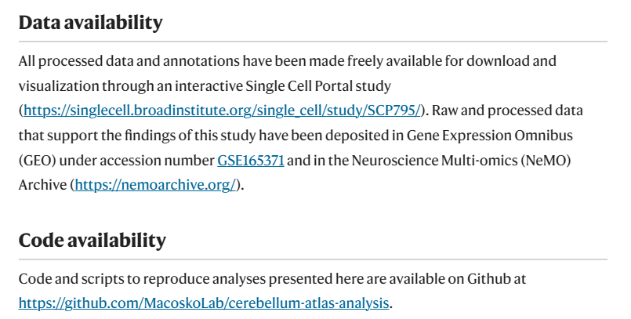
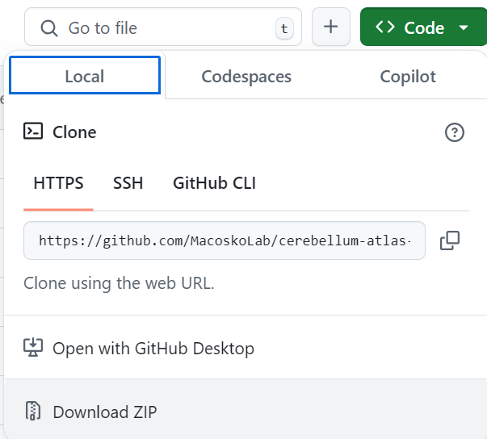
How do I use Github?
To access public repositories : nothing to do
1) Regular repo
https://www.nature.com/articles/s41586-021-03220-z
https://github.com/MacoskoLab/cerebellum-atlas-analysis
2) Colab : https://github.com/neuro4ml/exercises?tab=readme-ov-file
3) Ressources : https://github.com/ywang2822/Multi_Lick_ports_behavioral_setup

Slide 18
How do I use Github?
For editing Repositories, Three Ways
1 : Web Interface (github.com)
Great for browsing, quick edits, and project management
No installation needed, works everywhere. Not for cloning
2 : GitHub Desktop (this is what I use)
User-friendly application for Windows/Mac
Visual interface for common Git operations
3 : Command Line Interface (this is what I use when I do not have any choice)
Most powerful and flexible (all the github options)
Standard in software development
Required for advanced operations
➔ Each method can be used interchangeably based on your needs and comfort level

Slide 19
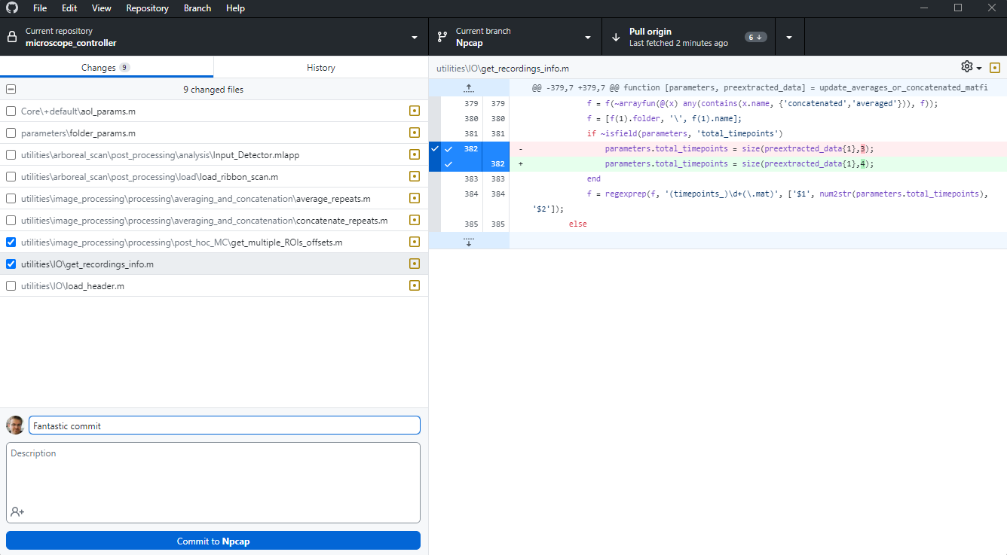
Github Desktop - demo

Slide 20
GitHub in Your Data Management Plan
What you can say :
Version Control & Documentation
→ Track and document all code changes systematically
→ Link specific code versions to experimental milestones and data
Research Reproducibility
→ Provide permanent links to exact code versions used in publications
→ Document computational methods transparently with commit history
Data & Code Preservation
→ Store analysis scripts and small datasets (<100MB)
→ Integration with Zenodo for DOIs and long-term archival
→ Meets many funders' open science requirements

Slide 21
GitHub in Your Data Management Plan
Planning Recommendations
→ Reference GitHub repositories in your DMP
→ Specify which code and small data will be version-controlled
→ Describe how larger datasets will be stored elsewhere
Remember: Your DMP should also include plans for storing large datasets in appropriate repositories (e.g., institutional repositories, domain-specific databases)
Template from my grant available in the GitHub repository

Slide 22
GitHub Benefits for Academia
Free GitHub Pro for Education at no cost Available for students, researchers, and teachers
https://education.github.com/discount_requests/application
GitHub Copilot Included
→ Works in GitHub's web editor
→ Integrates with VS Code and other IDEs for code suggestions in real-time
What Copilot Can Do
→ Suggests code completions and whole functions
→ Helps write documentation and comments
→ Understands context from your code
→ Assists with data analysis snippets
To Get Access : sign up in GitHub Education, using your unistra mail address. Teachers can get 2 pro accounts for organizations

Slide 23
Demo copilot and VScode
Notes:
https://github.com/SilverLabUCL/microscope_controller
Where are the function that controls analog I/O
how do i start the GUI?
# write a function that generate random noise and plot it
# write a function that generate random noise and plot it
import numpy as np
import matplotlib.pyplot as plt
def generate_noise():
return np.random.normal(0, 1, 1000)
def plot_noise():
noise = generate_noise()
plt.plot(noise)
plt.show()
if __name__ == "__main__":
plot_noise()

Slide 24
Getting Started with Git
Phase 1: Personal Use (our practical)
Install Git and GitHub Desktop, Create a GitHub account and set up Git locally
Start with a single personal project, Practice basic commits and readme files
Phase 2: Basic Workflow
Begin version controlling your analysis scripts, Learn to use branches for experiments
Add meaningful commit messages, Create basic documentation
Phase 3: Project Migration
Move existing research projects to Git
Phase 4: Collaboration
Create groups, Share repositories with lab members,
Start using issues for task tracking
Integrate with research tools (R Studio, Jupyter, Matlab, VSCode …)

Slide 25
Thank you for your attention!
The presentation will be available on
https://github.com/NeuroStrasbourg/GitHub-presentation-2025

Slide 27
Hands-On Session Program
Setup (10 min)
Install GitHub Desktop
Create a GitHub account
Sign in to GitHub Desktop
Clone the Repository https://github.com/NeuroStrasbourg/GitHub-presentation-2025
Pull the Latest Changes
Edit a File and Commit
Push Your Changes to GitHub
Pull Other People’s Changes
Create a New Branch
Make Changes on Your Branch
Merge Your Branch into Main
Final Step: Verify Everything is Up to Date

Slide 28
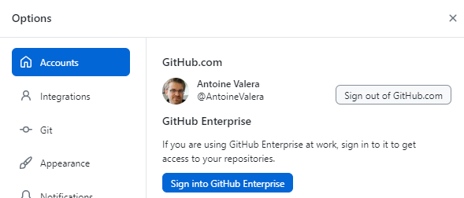
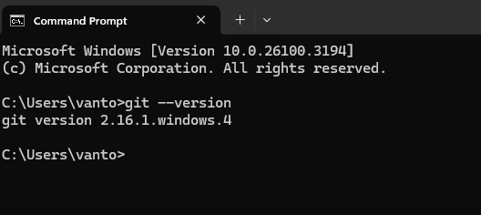
1 : Setup
Install Required Tools
Create a GitHub account: https://github.com/
Download and install GitHub Desktop: https://desktop.github.com/ Git is installed automatically with GitHub Desktop
Sign in to GitHub Desktop with your GitHub credentials
Ideally Verify Git Installation (for command line)
Check if Git is installed with
git --version
Options Menu should look like that
Windows + R, then type « cmd »

Slide 29
2 : Cloning a repository
Cloning your first repo via GitHub Desktop
Open GitHub Desktop
Click File → Clone Repository
In the URL tab, enter https://github.com/NeuroStrasbourg/GitHub-presentation-2025
Choose a local folder and click Clone

Slide 30
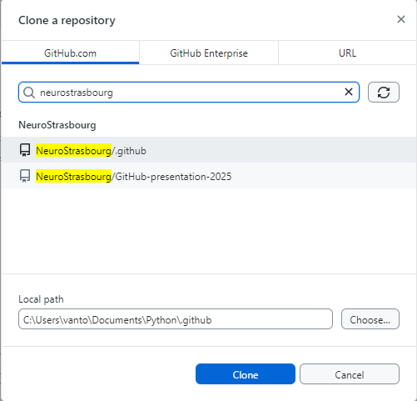
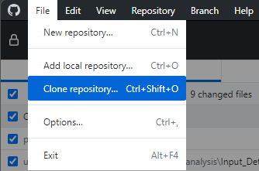

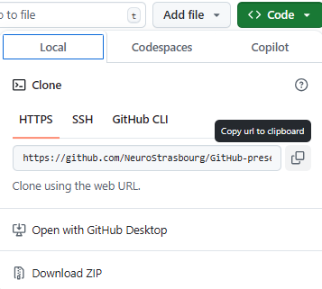
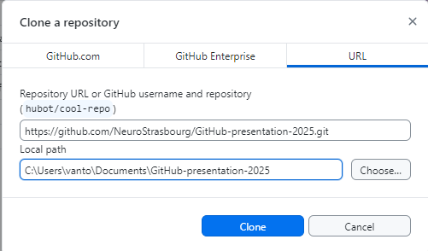
2 : Cloning a repository
Choose where to save it
If it’s a repo from one of your organizations
Otherwise
Choose where to save it

Slide 31
2 : Cloning a repository (command line)
Cloning via Command Line
If you follow instructions on a GitHub repo from a paper, you’ll often see that
git clone https://github.com/NeuroStrasbourg/GitHub-presentation-2025.git cd GitHub-presentation-2025
Common Issues & Tips
Ensure the repository URL is correct
If using SSH instead of HTTPS, replace the URL with (this depends on your git setup) git clone git@github.com:NeuroStrasbourg/GitHub-presentation-2025.git
If cloning fails, check your internet connection and GitHub permissions

Slide 32


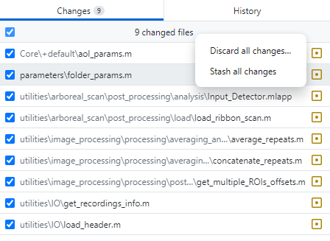
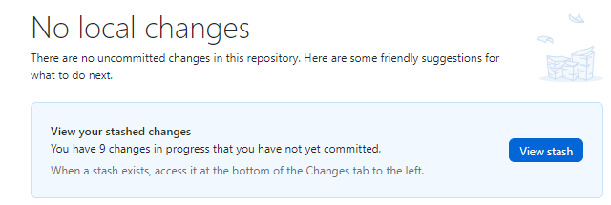
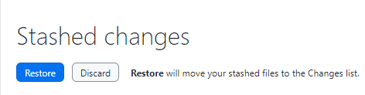
3 : Pull the latest Changes
Pulling the latest changes ensures your local repository is up to date with the remote version.
In GitHub Desktop, select the cloned repository from the list
Click on the "Fetch origin" button
If updates are available, click "Pull origin“
Important Note 1 : If some changes conflict with some non-committed local changes, you will need to solve conflicts (chose what to keep : the local or the remote?)
Important Note 2 : If you have local changes but you want to put them on the side temporarily, you can stash them (and later unstash them)
Stash
Restore

Slide 33
3 : Pull the latest Changes (Command Line)
Navigate to the repository folder
cd path/to/GitHub-presentation-2025
Run the pull command
git pull origin main
Common Issues & Tips
If you have local changes, commit or stash them before pulling
If a merge conflict occurs, resolve it manually and commit the changes
If the branch is different, specify it explicitly with git pull origin branch-name

Slide 34
4 : Edit Changes, Commit
Making changes and saving them as a commit allows you to track modifications in the repository.
Open the file “participants.txt” in the cloned repository in Notepad
Make some changes (including your name). Don’t remove other’s additions (please)
Go back to GitHub Desktop
You will see the changed files listed under “Changes”. Your additions will appear in green
Write a short commit message describing the changes
Click "Commit to main".
→ At this stage, you committed the change, but they are is still local.

Slide 35
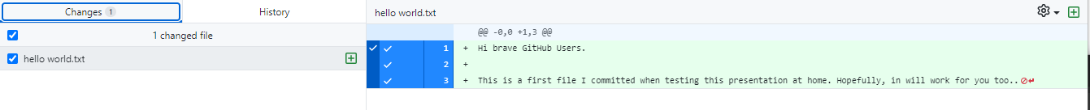
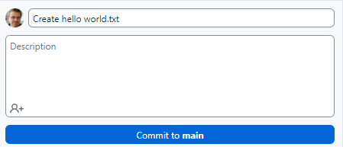

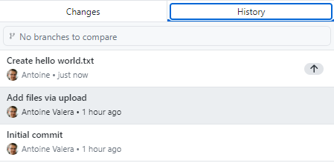
4 : Edit Changes, Commit
1: I created hello world.txt
2: I named the commit
Green lines are additions
4: At this stage, I can push to the online repository, or keep doing changes
3: Once committed, changes appear in the history tab. Local changes can be seen with the little up arrow next to it

Slide 36
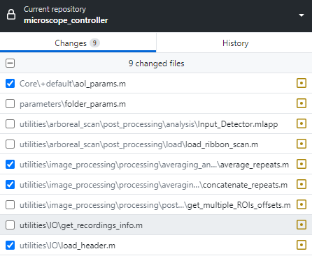
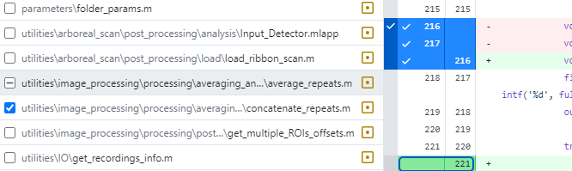
4 : Edit Changes, Commit (Advanced)
You do not have to commit all your changes at once.
You can sort them by groups.
You can also leave some changes uncommitted
Only files with a blue tick box arer « added » to the commit
You can even commit just a part of a file
This line in green was unselected (no blue tick in front) and will therefore not be part of the commit
« - » means that not all lines will be committed

Slide 37
4 : Edit Changes, Commit (Command line)
Edit or create a file in the repository folder
Check which files are modified git status
Add the modified files to the commit git add hello_world.txt
or to add all changes git add .
Verify what will be committed git status
Create a commit with a message git commit -m "Updated hello_world.txt with new content”
Common Issues & Tips
Use clear and concise commit messages
If you forget to add a file, use git commit –amend
If you need to discard local changes, use git checkout -- filename

Slide 38
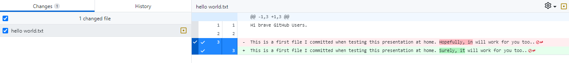
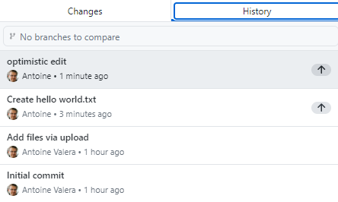



5 : Push your changes to GitHub
After committing changes locally, you need to push them to GitHub so others can see them.
Pushing via GitHub Desktop
After committing, click the Push origin button.
If other changes were done on the remote (by other users that pushed their changes), you’ll have to pull them first…
Another commit
Push!
Give it a name
Now there are 2 local commits

Slide 39


5 : Push your changes to GitHub (Cmd Line)
Push your commits to GitHub git push origin main
the word "origin" refers to the remote repository (on GitHub, GitLab, etc.) where your local branch will be pushed. This is the default name, but in doubt you can list your remotes.
git remote -v
If the push fails, someone else may have updated the branch; Before pushing, always run
git pull
If you’re on the wrong branch, Or you’re not sure you can check where you are with
git branch
And change branch with git checkout main
Use git log --oneline to verify your commits before pushing

Slide 40
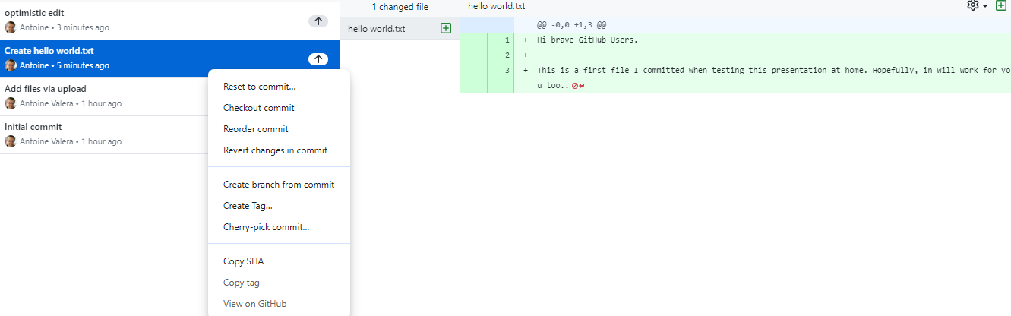
Adjusting commits (advanced)
Reset to commit…
Moves the branch pointer back to this commit, discarding all commits after it.
You can choose whether to keep changes (soft), remove them from the staging area (mixed), or completely discard them (hard).
Checkout commit
Moves your working directory to the selected commit, detaching the HEAD.
You won’t be on a branch anymore until you check out a branch again.
Reorder commit
Allows you to change the sequence of commits in history.
Revert changes in commit
Creates a new commit that undoes the changes made in the selected commit.
Create branch from commit
Creates a new branch from this specific commit.
Create Tag…
Tags the commit with a name, often for versioning.
Cherry-pick commit…
Applies the selected commit on top of another branch.
Copy SHA
Copies the unique commit identifier.
Copy tag
Copies the tag associated with the commit (if any).
View on GitHub
Opens the commit in the GitHub repository.

Slide 41
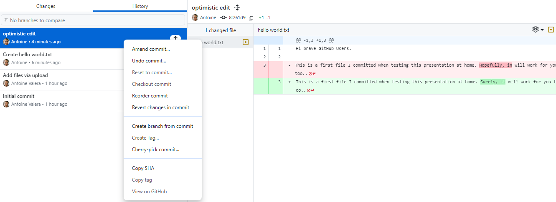
Adjusting commits (advanced)
The same +
Amend commit…
Modifies the latest commit without creating a new one.
Useful for fixing mistakes like commit messages or small file changes.
Undo commit…
Moves changes back to staging but removes the commit from history.
The changes remain intact for editing or re-committing.

Slide 42
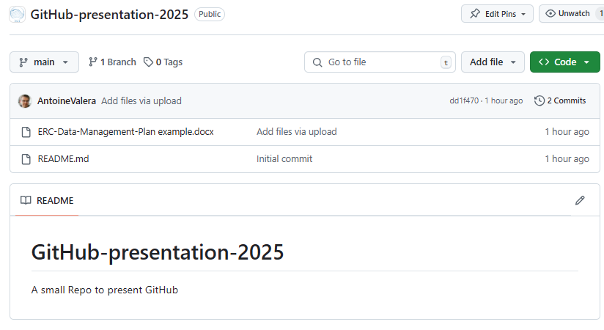
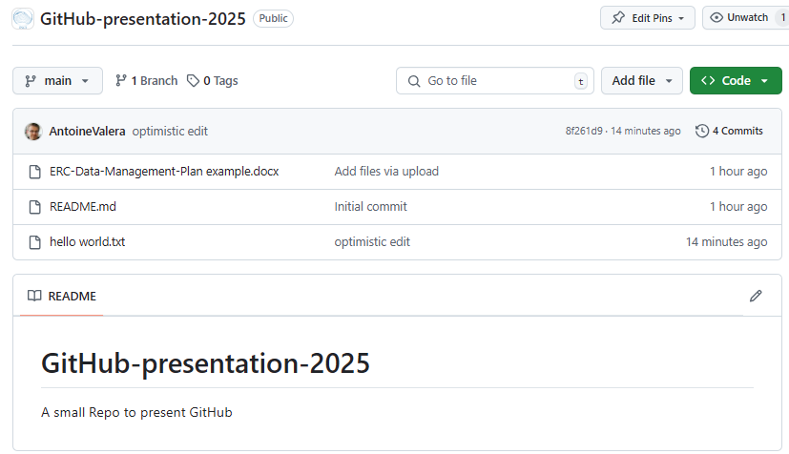
Did it work? Verify Changes on GitHub
Now that we have pushed our changes, let's check if they appear on GitHub.
Open a web browser and go to your repository: https://github.com/NeuroStrasbourg/GitHub-presentation-2025
Navigate to the Code tab, Find the modified file and check that the changes are there
Click on the file to view the modifications. Use the “blame” option to see when each part of a file was changed (or by whom)
Go to the Commits section to see the history of changes
← Before After →

Slide 43
6: Pull Other People’s Changes
If others have made updates to the repository, you need to pull their changes to stay up to date.
Click Fetch origin to check for new changes
If updates are available, click Pull origin
GitHub Desktop will update your local files
If there are conflicts with your local files you may want to stash them, or solve the conflict

Slide 44
6: Pull Other People’s Changes (Command line)
Navigate to the repository folder cd path/to/GitHub-presentation-2025
Pull the latest changes git pull origin main

Slide 45
7: Create a New Branch
A branch allows you to work on changes separately without affecting the main branch.
Click on the Current Branch dropdown
Click New Branch, Enter a branch name and click Create Branch
GitHub Desktop automatically switches to the new branch.
→ If you have uncommitted changes, GitHub Desktop will ask whether to leave them on the previous branch or bring them with you.
→ Commits made after creating the branch will belong to the new branch.
→ Commits made before creating the branch remain on the previous branch unless pushed.
Best Practice: Push Before Branching. Always push all local commits first, then create the branch to avoid losing track of work.
Publishing the Branch : A newly created branch exists only locally. It will only appear online after you publish it in GitHub Desktop.

Slide 46
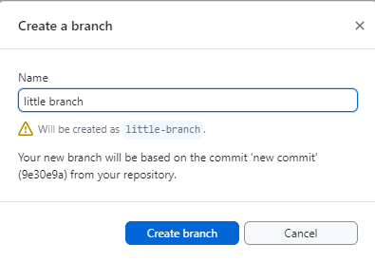
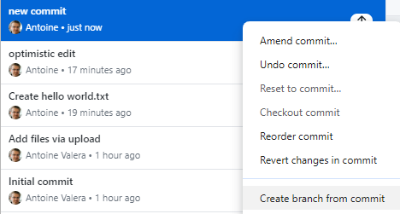
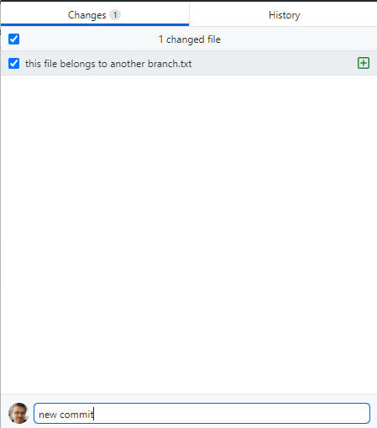

7: Create a New Branch
Find a clear and useful name
Create a new branch from the commit (alternatively, you can do it from the top menu)
Publish (it creates the branch online)
I did a new commit, but after thinking about it, it seems quite invovled. Maybe i should create a new branch

Slide 47
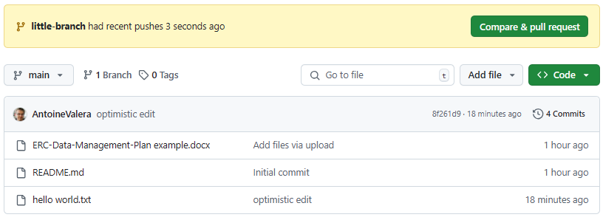
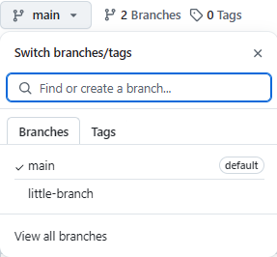
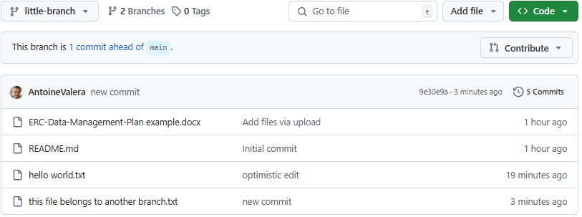
Did it work? Verify Changes on GitHub
Use this to switch in the website
The main branch
Very useful to know how different branches are
The new branch

Slide 48
7: Create a New Branch (Command Line)
Create a new branch git branch my-new-branch
Switch to the new branch git checkout my-new-branch or git switch my-new-branch
Use git branch to list all branches
Use git checkout -b my-new-branch to create and switch in one step
Uncommitted changes will come with you by default, unless you stash them first
Always name branches clearly, e.g., feature-update-text or bugfix-fix-typo

Slide 49
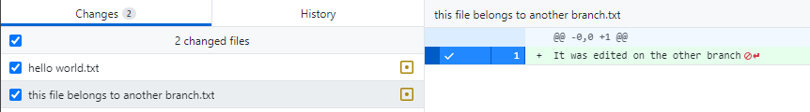
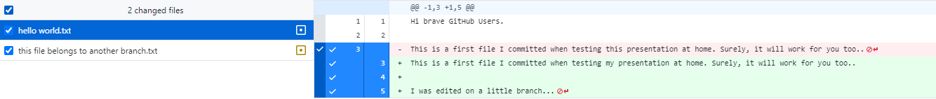

8 : Make Changes on Your Branch

Slide 50
8 : Make Changes on Your Branch (Cmd Line)
Before committing, always check that you are on the correct branch. Use
git branch
The active branch will have an asterisk (*) next to it. If needed, switch to your branch git checkout little-branch Verify again with git branch
Commit your changes git add . git commit -m "Your commit message"
If you accidentally committed on main, switch to little-branch and use
git cherry-pick to move the commit

Slide 51
9 : Merge Your Branch into Main
Now that you’ve committed and pushed changes on your branch, it's time to merge them into main.
Merging Without a Pull Request (For Small Projects)
If everyone can push directly to main:
In GitHub Desktop, go to the Current Branch dropdown
Switch to main
Click Fetch origin and then Pull origin to get the latest updates
Open the Current Branch dropdown again and select Merge into main
Select little-branch and click Merge little-branch into main
Click Push origin to update the remote repository
For larger teams and more regulated process, there is a mechanism called pull request. We’re not doing that today

Slide 52
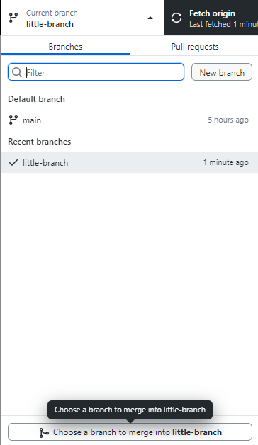
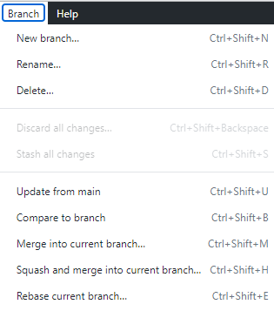
9 : Merge Your Branch into Main
You do not merge your current branch to another. You merge into your current branch.
Here we’re still on little-branch

Slide 53
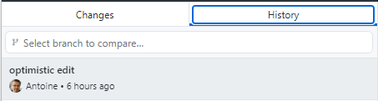
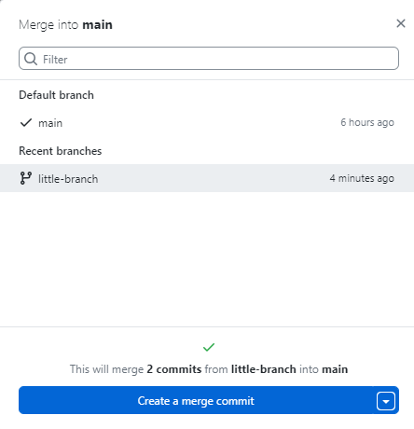
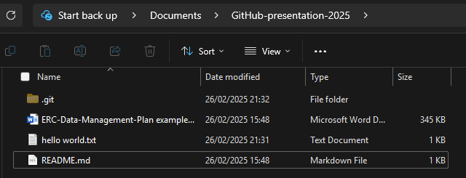

9 : Merge Your Branch into Main
Move to main. Our recent updates are not visible (yet)
Our new file appeared on main
Chose the branch to merge into main
The GUI will tell you if there will be conflict to solve. If you are ready, merge

Slide 54
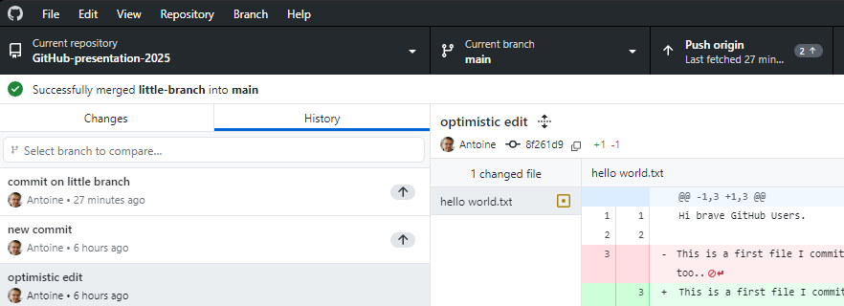
9 : Merge Your Branch into Main
Do not forget to push

Slide 55
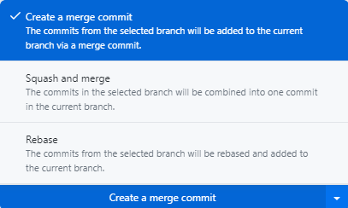
9 : Advanced merging concepts
Scenario: Commit on main between new commit and commit on little branch
Merge Commit: A new merge commit is created, preserving branch history. If conflicts exist, manual resolution is required.
Merge little-branch into main
commit on little branch
[New commit added in main]
new commit
optimistic edit
Create hello world.txt
Add files via upload
Initial commit
Squash and Merge: All commits from little-branch are combined into a single commit. The new commit is placed after [New commit added in main].
Squashed commit (all little-branch changes)
[New commit added in main]
optimistic edit
Create hello world.txt
Add files via upload
Initial commit
Rebase: little-branch commits are replayed on top of main. [New commit added in main] stays in its original position. Conflicts, if any, must be resolved manually.
commit on little branch
new commit
[New commit added in main]
optimistic edit
Create hello world.txt
Add files via upload
Initial commit

Slide 56
9 : Merge Your Branch into Main (Command line)
Merging Without a Pull Request (For Small Projects)
If you are working on a small project where everyone can push directly to main:
Switch to main git checkout main or git switch main
Get the latest updates git pull origin main
Merge your branch into main git merge little-branch
Push the updated main branch git push origin main

Slide 57
9 : Merge Your Branch into Main (Cmd line + Web)
Using a Pull Request (For Larger Teams or Managed Main Branch)
If someone is responsible for main or you want to review changes before merging:
Push your branch git push origin little-branch
Go to your GitHub repository https://github.com/NeuroStrasbourg/GitHub-presentation-2025
Click Compare & pull request
Review changes, then Create pull request
The person managing main will review and merge
Common Issues & Tips
Always pull the latest main before merging to avoid conflicts
If there are merge conflicts, Git will notify you—resolve them manually, then commit
For team projects, pull requests help track changes and prevent accidental overwrites

Slide 58
Thank you and congratulations if you made it there!
The presentation will be available on
https://github.com/NeuroStrasbourg/GitHub-presentation-2025

